Slide 1
Path Optimization of UCLA for the Physically Disabled
Jason Liu | Ryan Liu | Hamza Khan | Shaash Sivakumar | Marc Walden

Slide 2
Problem Description
Physically Disabled Students comprise 2.1% of UCLA student body (almost 1000 students)
Campus constructed with steep slopes and stairs to account for dramatic changes in elevation
Accessibility issues for disabled students, as current routes are very inefficient and inconvenient
Wheel transportation including skateboards and electric scooters are also inconvenient
Notes:
hamza

Slide 3
Goals of the Model
Identify least accessible areas on campus and propose efficient alternatives
Simulate a physically disabled individual and a control non-disabled individual walking different routes of campus
Use path optimization algorithms to produce the most efficient route to a given destination
Compare the mean travel times between simulations and discuss why paths are inefficient
Propose solutions to inefficient paths
Notes:
hamza

Slide 4
Simplifications and Assumptions
Confining model to a rectangle of UCLA with Bunche Hall, Anderson School of Management, Ackerman Turnaround, and Pritzker Hall denoting the four corners
Use strategically selected notes that encompass the regions possible paths
Use manual wheelchair user as the physically disabled simulation
Assume a pace of 2 mph for wheelchair user and 3 mph for control regardless of fatigue/length of travel
Assume natural gradient of deceleration for inclines
Assume inclines above 35 degrees are inaccessible
Notes:
ryan

Slide 5
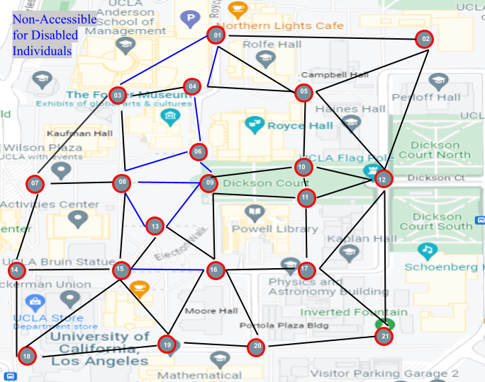
Modeling (Graph Theory)
Nodes: Selected 21 key intersections on campus
Paths: All existing connections between 2 nodes
Notes:
ryan

Slide 6
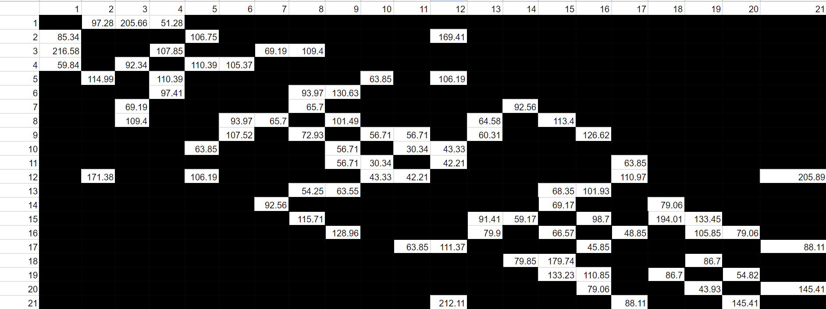
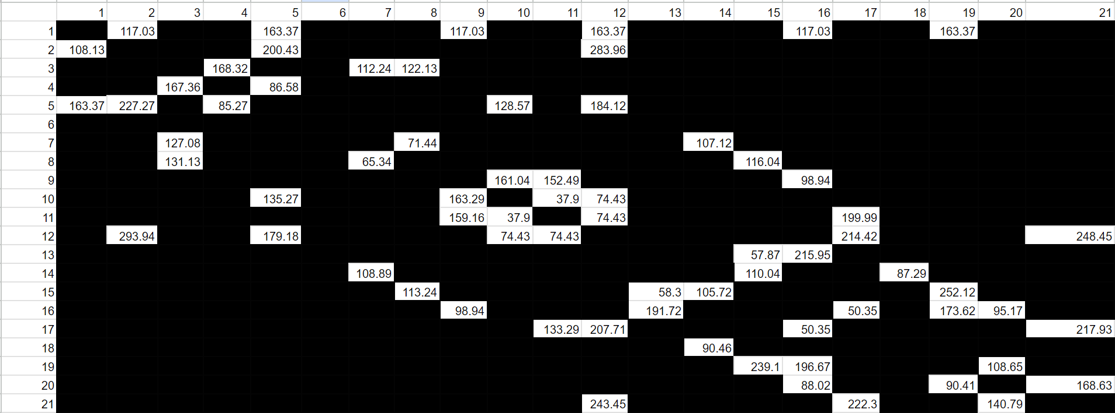
Data Collection
0: Non-disabled
1: Disabled
Simulated average walking and wheelchair speed to traverse through all possible paths, collected time
Assumed 2 mph for disabled speed, 3 mph for non-disabled speed
Assume natural gradient of pace decrease when walking up slope, also any route that requires above 35 degree incline is inaccessible for wheelchair
Recorded times (in seconds, nearest hundredth) as the weight for each path
Notes:
ryan

Slide 7
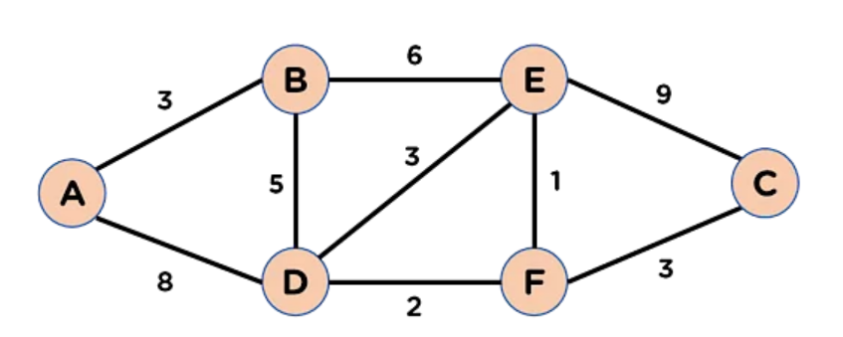
Method 1 - Dijkstra’s Algorithm
Objective: To find the minimum time from starting node to ending node
Process: To find the time it takes to go from A to B for example, compare the time from A to B with the time it takes to go from A to all the nodes in between A and B and then from that node to B. The smallest of these times replaces our value from A to B.
End > v Start | A | B | C | D | E | F
A | 0 | 3 | ∞ | 8 | ∞ | ∞
B | 3 | 0 | ∞ | 5 | 6 | ∞
C | 3 | ∞ | 0 | ∞ | 9 | 3
D | 8 | 5 | ∞ | 0 | 3 | 2
E | ∞ | 6 | 9 | 3 | 0 | 1
F | ∞ | ∞ | 3 | 2 | 1 | 0
End > v Start | A | B | C | D | E | F
A | 0 | 3 | 13 | 8 | 9 | 10
B | 3 | 0 | 10 | 5 | 6 | 7
C | 13 | 10 | 0 | 5 | 4 | 3
D | 8 | 5 | 5 | 0 | 3 | 2
E | 9 | 6 | 4 | 3 | 0 | 1
F | 10 | 7 | 3 | 2 | 1 | 0
To find the time it takes to go from A to E, find all the nodes in between A and E, (B and D) and then use those paths to find the quickest path.
Notes:
shaash

Slide 8
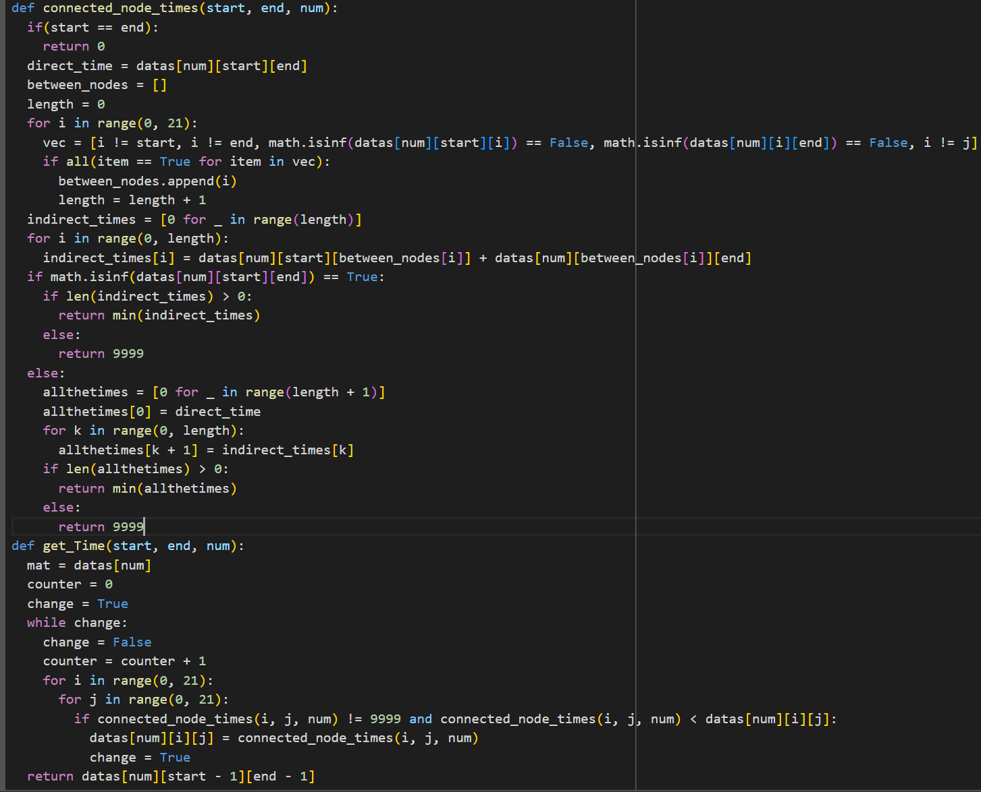
Code Snippet
datas is a matrix that contains all the times, where the row number represents the start-node and the column number represents the end-node
Connected_node_times calculates the minimum time required to go from start-node to finish-node, if the start-node and finish-node are either a direct path or if they have one node in between. If that’s not the case, it returns 9999 (representing infinity).
get_Time calculates the minimum time to go from any start-node to any end-node. It keeps updating the minimum time to go from any start-node to any end-node until the matrix stores the minimum time for all paths. Then, it accesses the time from the matrix
Notes:
shaash

Slide 9

Method 2 - Least Resistance Algorithm
Analog- electricity arcing through a non uniform material
Steadily increase Voltage: amount of weight the algorithm allows current paths to overcome (ignoring initial values)
Construct & maintain two arrays, representing possible paths that can be achieved from start and end nodes (respectively), within the current voltage (end paths are reversed times)
Algorithm iteratively explores all possible paths for both these arrays, building a collection of paths as the voltage increases
Eventually, paths converge (either discretely or continuously), representing the shortest route to get from start to end
Notes:
Jason

Slide 10
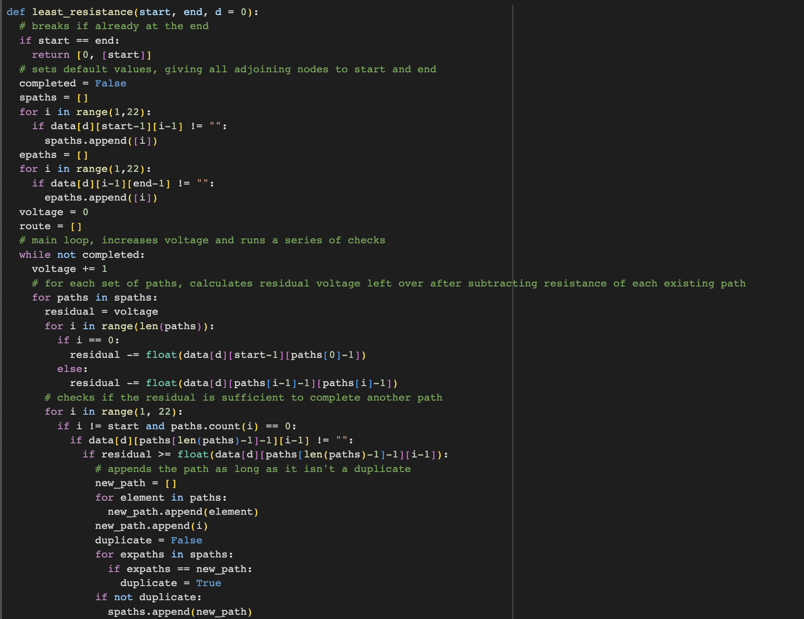
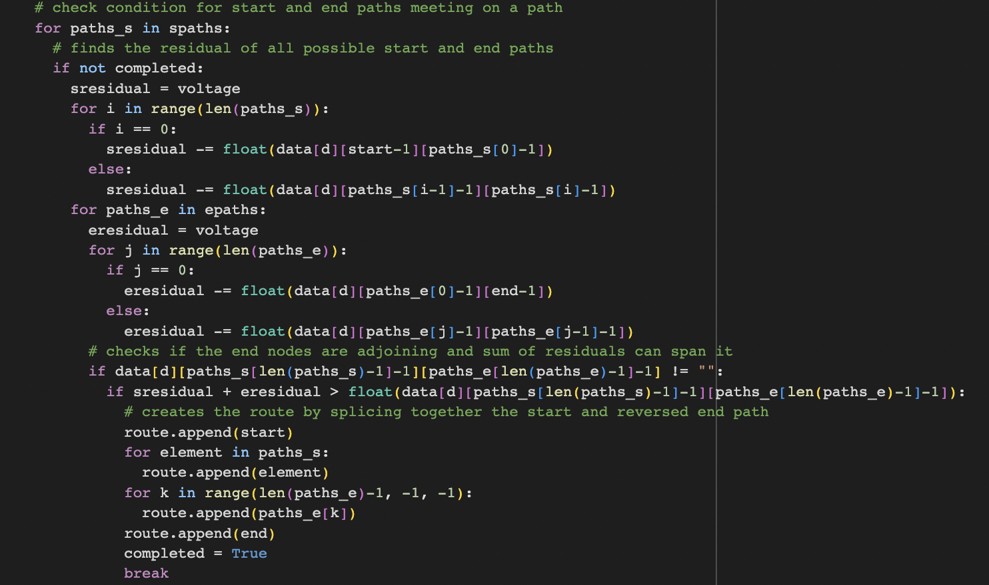
Code Breakdown
Initial Values for Path Arrays: Searches for any nodes adjacent to start and end
Iterates through existing start array paths, if voltage allows it to, adds any extensions as a new path (non duplicate)
Same thing implemented for ending array paths (not shown)
Discrete: Use boolean checklist to check if paths end in the same node
Continuous: If paths end in connecting nodes, check to see if remaining voltage is enough to traverse between the nodes
Route constructed by reordering and combining paths
Accurate time (0.01) found by adding the weights of each route pair
Notes:
Jason

Slide 11
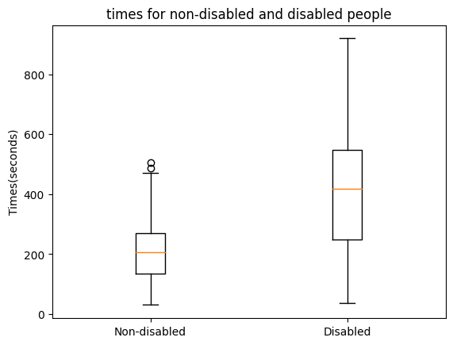
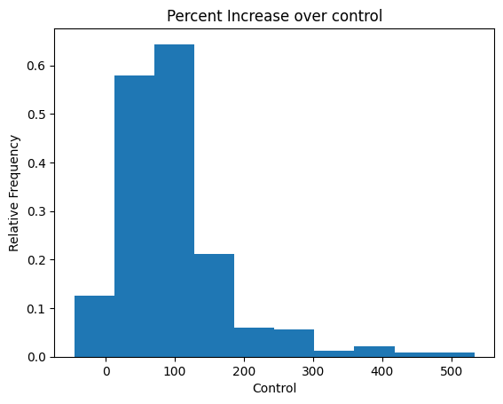
Results
98% accuracy for least resistance algorithm
Based on the plot, average times for disabled is much higher than non-disabled
Mean times: 211 vs 390 (+85%)
Longest Routes Mostly Involved:
15-19: extremely inefficient winding slope
8-9: can’t use stairs, need to use the winding slope again
4-1: indirect, requires u-turn
Possible Solutions:
15-19: build exterior elevator. (90s)
Mean time: 374
8-9: create ramp next to steps. (270s, 240s)
Mean time: 383
4-1: create route through/around. (160s)
Mean time: 385
Mean time with all 3 solutions: 362
Notes:
marc

Slide 12
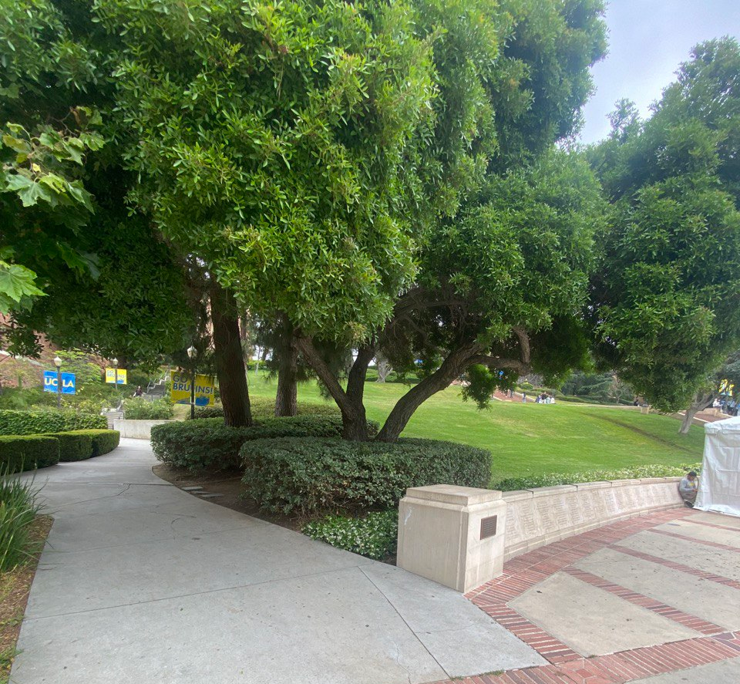
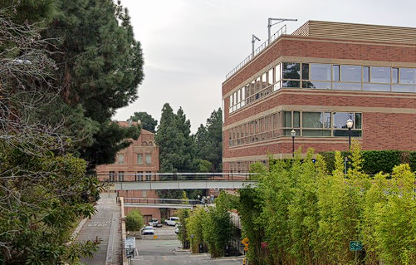
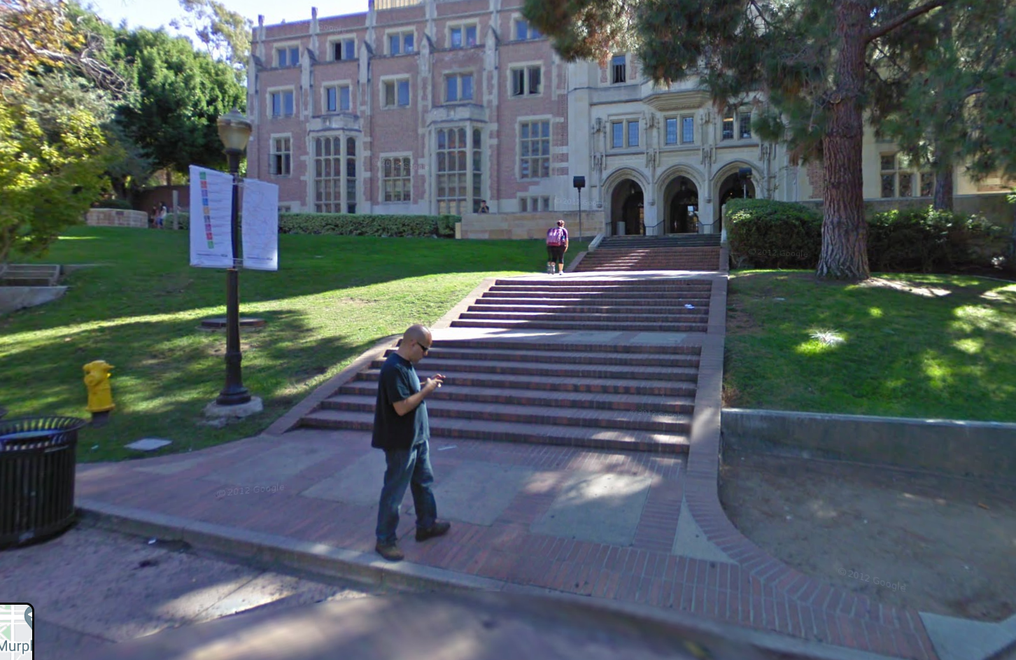

Slide 13
Future Improvements
Improve accuracy of least resistance model
Possible expansion to more areas, perhaps even areas of Los Angeles
Database expansion, account for more areas of UCLA
Include indoor or smaller paths
Automation in data collection (Google Maps API Calls)
Expand to include different modes of transport
Include stochastic factors, such as congestion and traffic signals
Notes:
hamza

Slide 14
References
Kapoor, Anmol. “What Is Dijkstra’s Algorithm? Here’s How to Implement It with Example?” Simplilearn.Com, 21 Feb. 2023, www.simplilearn.com/tutorials/cyber-security-tutorial/what-is-dijkstras-algorithm.
Maverick, John. “How Fast Can a Manual Wheelchair Go: Helpful Guide 2023.” Wheelchairsvilly.Com, 24 Jan. 2023, wheelchairsvilly.com/how-fast-can-a-manual-wheelchair-go/.
Metterhausen, Fred. “Elevation Calculator: Find Your Current Elevation, an Address, or a Point on the Map.” Elevation Calculator: Find My Elevation on a Map., www.mapdevelopers.com/elevation_calculator.php. Accessed 13 June 2023.
Systems, UCLA Facilities Management Information. Map.Ucla.Edu, map.ucla.edu/. Accessed 13 June 2023.
Wilson, Robin J. Introduction to Graph Theory. Prentice Hall, 2015.

Slide 15
Thank You!

